Slide 1
Core data structures
It’s all about relationships
Terence Parr
MSDS program University of San Francisco

Slide 2
Data structures organize data
Data structures group or encode relationships between data elements
There’s a difference between the abstract data type and the implementation (list vs array, dictionary vs hashtable, …)
Two methods to organize data:
physical adjacency or relative position in RAM
pointers
Algorithms operate on data structures; e.g., sorting algorithm operates on a list
Often algorithms are needed to construct structures too but let’s get familiar with what these data structures look like and then focus on algorithms that operate on them

Slide 3
Advice on choosing data structures
Use the simplest data structure you can initially because you never know if that code will survive very long
Waste processor, memory power before brainpower (if possible)
There is a trade off between time and space
We can often make faster algorithm using more memory
It’s like driving to the other side of town to save 5% on beer; what are you trying to optimize? time or $$$
Prep work or more sophisticated data structure can help
E.g., element lookup via: unordered list vs sorted list vs hash table O(n) O(log n) O(1)

Slide 4
Why you should know about DS/Alg
Date: Wed, 18 Oct 2000 03:00:00 -0700 (PDT)
From: phillip.allen@enron.com
To: leah.arsdall@enron.com
Subject: Re: test
Mime-Version: 1.0
Content-Type: text/plain; charset=us-ascii
…
Consider Enron emails
Represent how?
Depends on what?
Depends on the info we want to extract
Find all emails by Keith
Find email path from Keith to Phillip or find path length
Find all direct emailers to Keith
Date: Mon, 16 Oct 2000 06:42:00 -0700 (PDT)
From: phillip.allen@enron.com
To: buck.buckner@honeywell.com
Subject: Re: FW: fixed forward or other Collar floor gas price terms
Mime-Version: 1.0
Content-Type: text/plain; charset=us-ascii
…
Date: Mon, 9 Oct 2000 07:00:00 -0700 (PDT)
From: phillip.allen@enron.com
To: keith.holst@enron.com
Subject: Consolidated positions: Issues & To Do list
Mime-Version: 1.0
Content-Type: text/plain; charset=us-ascii
…
https://www.kaggle.com/wcukierski/enron-email-dataset

Slide 5
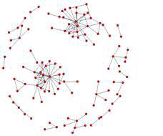
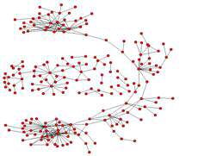
What can we learn, what alg’s do we need
Fast string search to find emails
Compute edit distance to find similar or misspelled email addrs
Shortest path analysis to discover company relationships not on org chart
k-cliques (subcommunities) became more common as crisis built at Enron
Date: Mon, 9 Oct 2000 07:00:00 -0700 (PDT)
From: phillip.allen@enron.com
To: keith.holst@enron.com
Subject: Consolidated positions: Issues & To Do list
Mime-Version: 1.0
Content-Type: text/plain; charset=us-ascii
…
See Social Network Analysis and Organizational Disintegration: The Case of Enron Corporation

Slide 6
Elemental data in memory (RAM)
(not disk formats, we covered in data acquisition MSDS692)
What’s the type?: typically int, float, string
Numbers can be of different sizes; e.g., np.float32, np.float64
Data values: an int can represent a number, signed or unsigned, but can also represent a categorical item such as US state
We can also use strings for categorical but it’s much less efficient in space, and often time
You can even encode multiple things within a single number, such as 5 and 32005 could be a combined 32 and 5
Data properties: e.g., can such values be ordered? Is there a notion of distance between values?

Slide 7
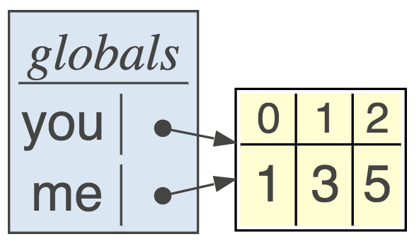
Pointer data type
A pointer p is implemented as an integer variable that holds a memory address, such as “p = Point(3,4)”
Python knows variable is actually a reference to memory location
Pointers are also called references
you = [1,3,5]
me = you

Slide 8
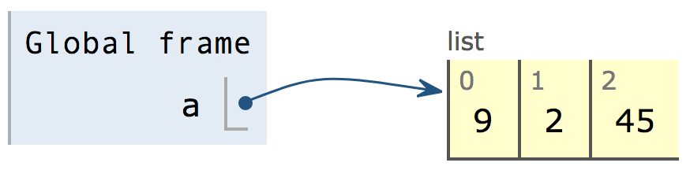
List abstract data type
Array implementation is most common for list abstract data structure
Lists are ordered but items aren’t necessarily sortable
Arrays use contiguous memory locations to associate items
Code “a=[9,2,45]” yields a pointer to contiguous block of cells

Slide 9
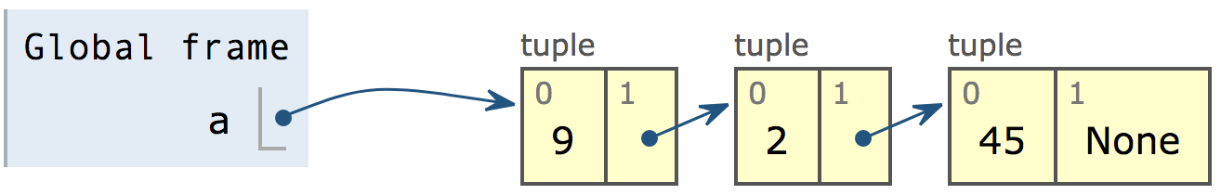
Non-contiguous lists: linked lists
The other way to implement a list data type is with explicit pointers from one element to the next: “a = (9,(2,(45,None)))”

Slide 10
Queue: ordered list
First In, First Out (FIFO); Key ops: ENQUEUE, DEQUEUE
A list restricted to add to the end and delete from the front
Most commonly an array implementation

Slide 11
Stacks: like stacks of plates
Most commonly an array implementation
First In Last Out (FILO); key ops: PUSH, POP
Just a list restricted to add items to end and take from the end
For us, possibly used as “work list” for non-recursive tree walking
push Maria
push Xue
push Tom
pop
pop

Slide 12
Set: unordered, unique collection
Typical implementation is a hash table
Operations are add, delete, contains, union, intersection, etc…
“contains” operation takes constant time for hashtable implementation

Slide 13
Dictionary abstract data structure
Maps key to value; i.e., d[key] = value
Look up values by key; i.e., d[key]
Hashtable is implementation of choice
Recall hashtable is array of buckets, each bucket is array of (key,value) pairs

Slide 14
Binary tree abstract data structure
A directed-graph with internal nodes and leaves
No cycles and each node has at most one parent
Each node has at most 2 child nodes
For n nodes, there are n-1 edges
A full binary tree: all internal nodes have 2 children
Height of full tree with n internal nodes is about log2(n)
Height defined as number of edges along path root->leaf
Level 0 is root, level 1, …
Note: binary tree doesn’t imply binary search tree

Slide 15
Binary tree implementation using pointers

Slide 16
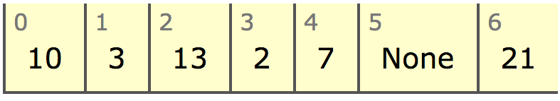
Concrete binary tree using contiguous array
We don’t need child pointers!
left child is 2i+1
right child is 2i+2

Slide 17
Indexes as pointers
sklearn doesn’t use nodes with pointers
Uses node ID’s and parallel arrays like left, right, value
0
left[0] = 1
left[1] = 2
left[2] = -1
left[3] = -1
left[4] = -1
left[5] = -1
right[0] = 4
right[1] = 3
right[2] = -1
right[3] = -1
right[4] = 5
right[5] = -1
value[0] = 10
value[1] = 3
value[2] = 2
value[3] = 7
value[4] = 13
value[5] = 21
1
4
2
3
5

Slide 18
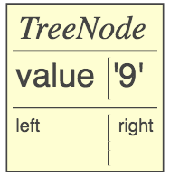
Constructing binary search trees
Result of add() function is the modified tree
Initial condition: add to None:
If node.value==value, return that node:
def add(p:TreeNode, value) -> TreeNode :
if p is None: return TreeNode(value)
if value < p.value: p.left = add(p.left, value)
elif value > p.value: p.right = add(p.right, value)
return p # do nothing if equal (already there)
root = add(None, 9)
root = add(root, 9)

Slide 19
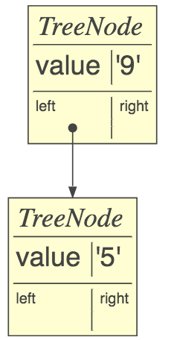
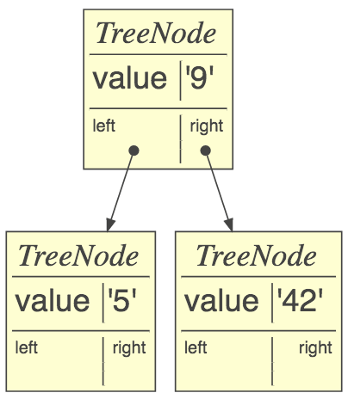
Constructing binary search trees cont’d
If value < current node, add to the left
If value > current node, add to the right
if value < p.value: p.left = add(p.left, value)
root = add(root, 5)
root = add(root, 42)

Slide 20
Consider similarity of search / build
def search(p:TreeNode, x:object):
if p is None: return None
if x < p.value:
return search(p.left, x)
if x > p.value:
return search(p.right, x)
return p
def add(p:TreeNode, v):
if p is None: return TreeNode(v)
if v < p.value:
p.left = add(p.left, v)
elif v > p.value:
p.right = add(p.right, v)
return p

Slide 21
Graphs
An arbitrary number of outgoing edges, not just 2 like binary trees
Or, use an adjacency matrix
Edges can have labels or not
Edges can be directed or undirected
Can be pointed at by any number of nodes
Cycles are ok unless specified otherwise; e.g., directed acyclic graph (DAG) is a semi-common term
blue image from https://skymind.ai/wiki/graph-analysis

Slide 22
Basic node definitions
(Tattoo these somewhere)
class LLNode:
def __init__(self, value, next=None):
self.value = value
self.next = next
class TreeNode:
def __init__(self, value, left=None, right=None):
self.value = value
self.left = left
self.right = right
only edges differ
class Node:
def __init__(self, value):
self.value = value
self.edges = [] # outgoing edges

Slide 23
Summary
Abstract data types: List, Set, Queue, Stack, Dictionary, Binary tree, Graph
Concrete implementations: arrays, linked lists, node object with 1+ outgoing edge pointers
The questions you must ask of the data dictates the data structure and algorithms you need
Waste processor, memory power before brainpower (start with simplest data structure that will work)

